Slide 1
Metropolitan Areas of Mexico
IOP México. 2022

Slide 2
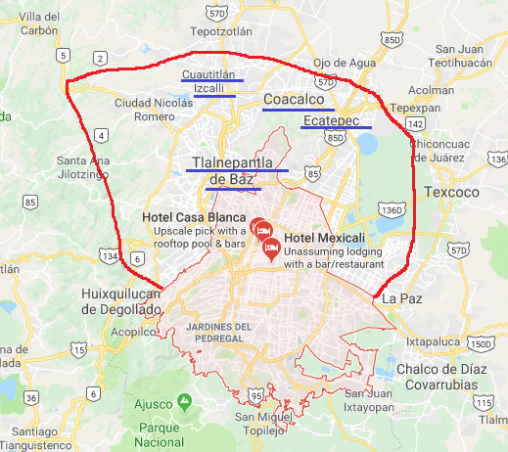
Metropolitan Areas of Mexico
Mexico City
Mexico City ( MXMEX)
ALVARO OBREGON
BENITO JUAREZ
AZCAPOTZALCO
COYOACAN
CUAJIMALPA
CUAUHTEMOC
GUSTAVO A MADERO
IZTACALCO
IZTAPALAPA
MAGADALENA CONTRERAS
MIGUEL HIDALGO
VENUSTIANO CARRANZA
MILPA ALTA
TLAHUAC
TLALPAN
XOCHIMILCO
Other places of Metropolitan Area of Mexico City
Name | Code
NAUCALPAN | MXNDJ
TLALNEPANTLA | MXTLP
CUAUTITLAN IZCALLI | MXCUT
TULTITLAN | MXTLL
NEZAHUALCOYOTL | MXNHY
COACALCO | MXCDB
ECATEPEC | MXEPC
LOS REYES | MXRYA
HUEHUETOCA | MXHUE
SATELITE | MXNDJ
ATIZAPAN | MXAZP
TEPOTZOTLAN | MXTPZ
TULTEPEC | MXTTP
CHIMALHUACAN | MXCMH

Slide 3
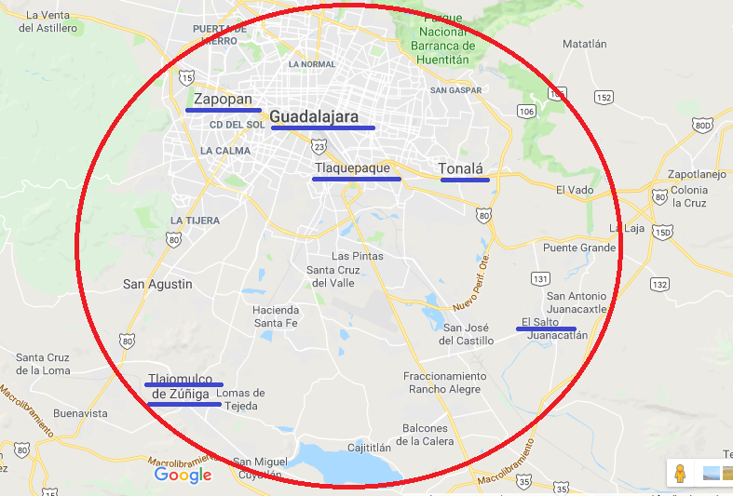
Metropolitan Areas of Mexico
Guadalajara
Guadalajara (MXGDL)
GUADALAJARA
Other places of Metropolitan Area of Guadalajara
Name | Code
TLAQUEPAQUE | MXTLQ
ZAPOPAN | MXZAP
TLAJOMULCO DE ZUÑIGA | MXTLZ
TONALA | MXTON
EL SALTO, JALISCO | MXESO

Slide 4
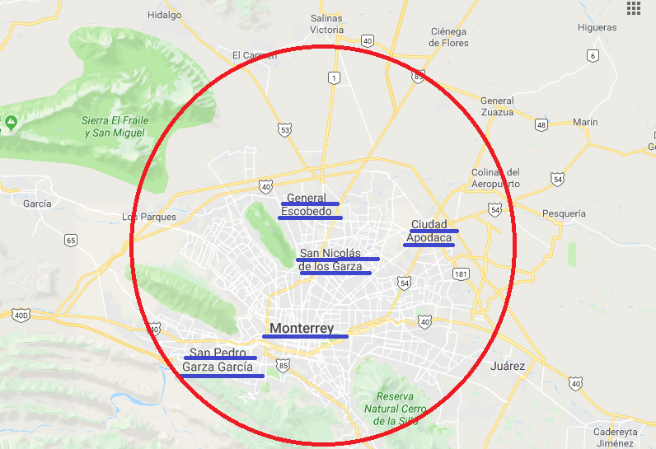
Metropolitan Areas of Mexico
Monterrey
Monterrey ( MXMTY)
MONTERREY
Other places of Metropolitan Area of Monterrey
Name | Code
APODACA | MXAPD
GENERAL ESCOBEDO | MXGEO
GUADALUPE | MXGLP
SALINAS VICTORIA | MXSAV
SAN PEDRO GARZA GARCIA | MXSPG
SAN NICOLAS DE LOS GARZA | MXSND
GARCIA | MXGCA
SANTA CATARINA | MXSTC

Slide 5
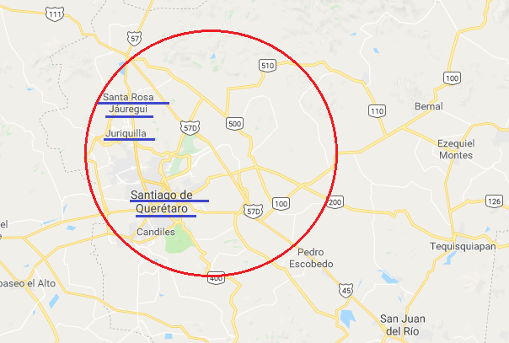
Metropolitan Areas of Mexico
Querétaro
Querétaro ( MXQRO)
SANTIAGO DE QUERETARO
Other places of Metropolitan Area of Queretaro
Name | Code
SANTA ROSA DE JAUREGUI | MXSRO
EL MARQUES DE QUERETARO | MXELM
JURIQUILLA | MXJRQ

Slide 6
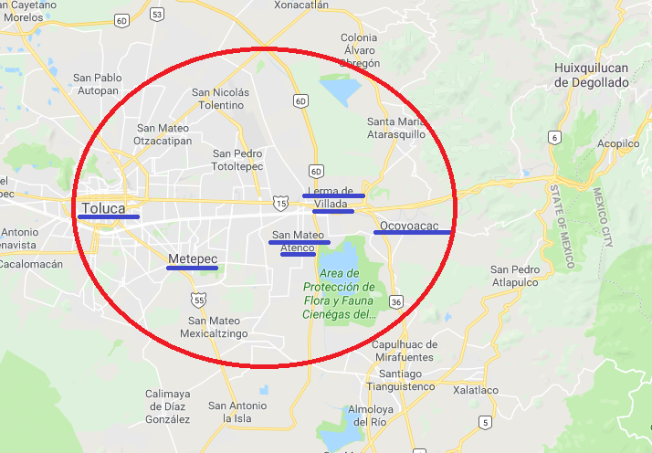
Metropolitan Areas of Mexico
Toluca
Toluca ( MXTLC)
TOLUCA
Other places of Metropolitan Area of Toluca
Name | Code
LERMA | MXLER
SAN MATEO ATENCO | MXSMA
OCOYOACAC | MXOYO
METEPEC | MXMPC

Slide 7
Thank you.

